Slide 1
Sprocket Central Pty Ltd
Targeted Marketing Analytics
Nguyen Tran

Slide 2
Agenda
Data Cleaning
Data Exploration
Model Development
Interpretation

Slide 3
Data Cleaning
Data Quality Issues
 | Customer Demographic | Customer Addresses | Transaction Data
Accuracy | DOB: Inaccuracy Job Industry Category: Misspelling
Completeness | DOB: Blanks Job Title: Blanks Job Industry Category: Blanks Tenure: Blanks Customer IDs: Not in Sync | Customer IDs: Not in Sync | Standard Cost: Blanks Brand: Blanks Product Line: Blanks Product Class: Blanks Product Size: Blanks Product First Sold Date: Blanks Customer IDs: Not in Sync
Consistency | Gender: Inconsistency | States: Inconsistency
Currency | Deceased Customers: Filter Out
Relevancy | Default: Exclude Field |  | Order Status: Exclude Cancelled
Validity |  |  | Product First Sold Date: Format

Slide 4
Data Cleaning
Cleaning Overview
Records with Missing Fields were Dropped.
Only customers in CustomerDemographic table were included for training.
Age, Last Purchase (Days Ago), Profit Fields, Median Salary by post code, etc. were added.
Records pertaining to Deceased Customers were Dropped.
Customers with missing Transactions were Dropped.
Distinct Customer IDs As Received | 4,000
Distinct Customer IDs after Data Cleaning | 3,485

Slide 5
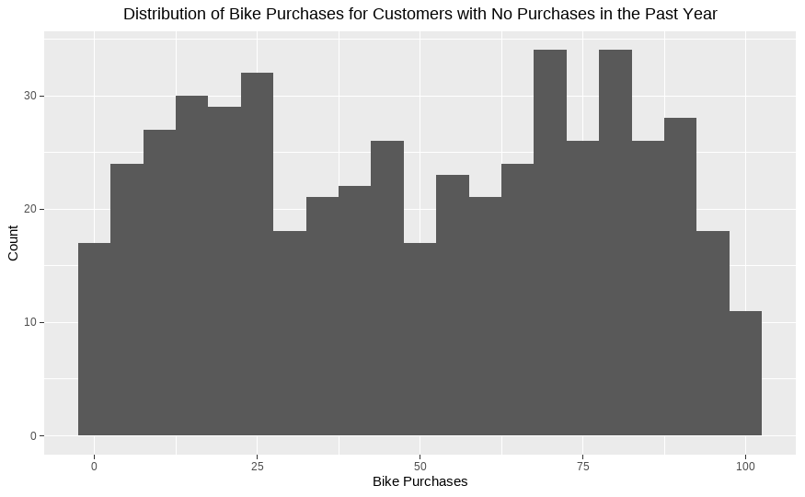
Data Exploration
Distribution of Existing Customers by Value segment
The 508 with missing 2017 transactions seems to be two populations of customers: those who have made less than average bike purchases, and those who have made more than the average.
We recommend checking in with the existing customers in the second population to see if they are still interested in our products.

Slide 6
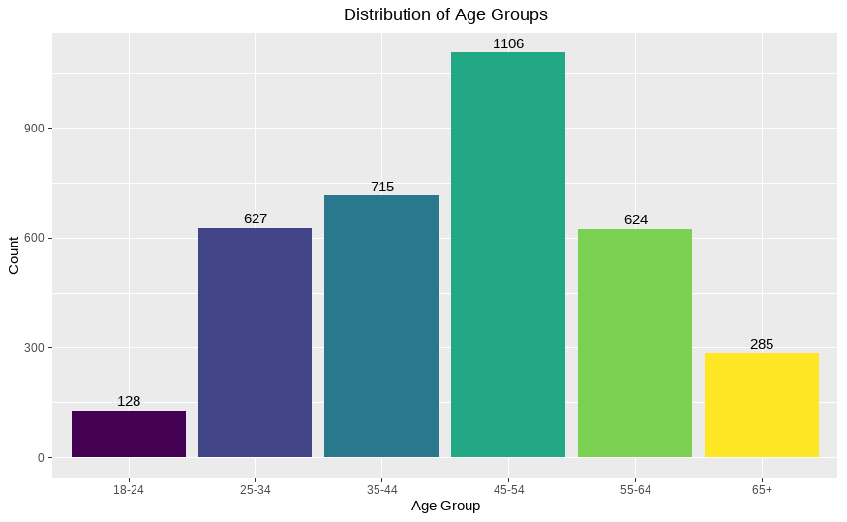
Data Exploration
Age distribution of Existing Customers
Our customer base is mostly made up of middle-aged customers, with the 45-54 age group being the largest.

Slide 7
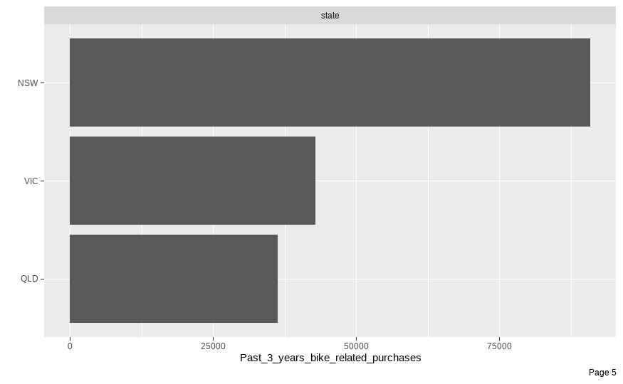
Data Exploration
Distribution of Existing Customers by State
New South Wales customers love our bike products.

Slide 8
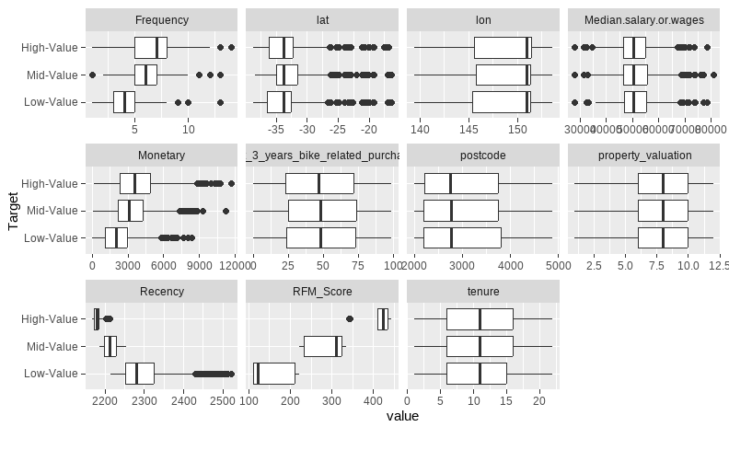
Data Exploration
Existing Customers by Numeric variables and Value segment
Surprisingly, tenure, median salary by postcode, property valuation, 3 years bike related purchases are all the same across Customer Value segment.
This might explain how the current data might not help predict new high-value customers accurately.

Slide 9
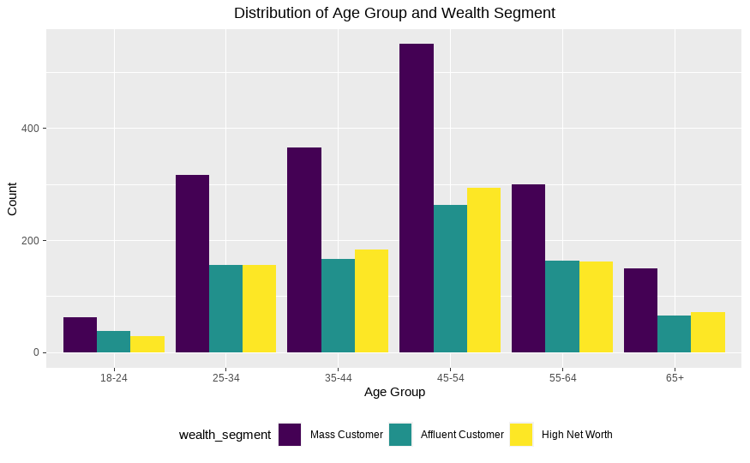
Data Exploration
Existing Customers by Age Group and Wealth segment
Our customer base is primarily Mass Customer segment.

Slide 10
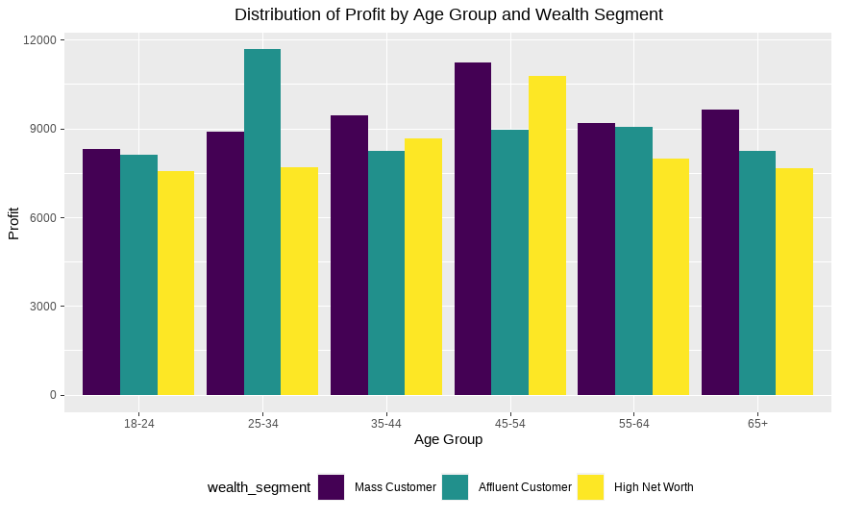
Data Exploration
Existing Customers’ Profit by Age Group and Wealth segment
Across age groups, the Mass Customer segment brings in the most profit, except in the 25-34 age group, where the Affluent Customer segment takes the lead.
We recommend looking into this 25-34 age group to see if we have maximized our effort for this group.

Slide 11
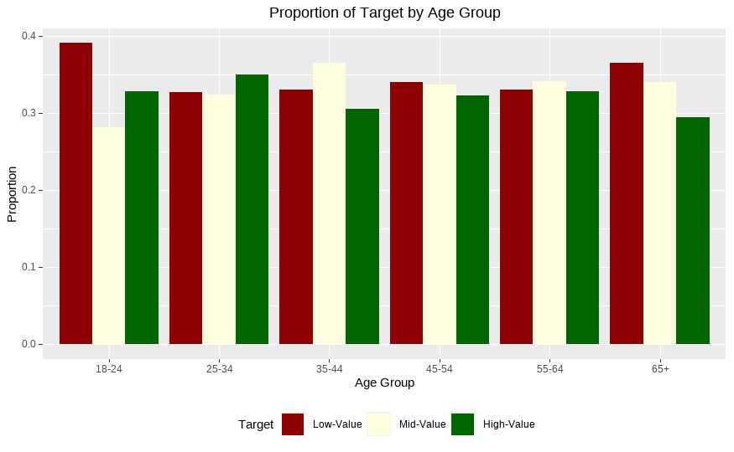
Data Exploration
Existing Customers by Age Group and Wealth segment
Across all age groups, 18-24 year olds are the most likely to be low-value customers.

Slide 12
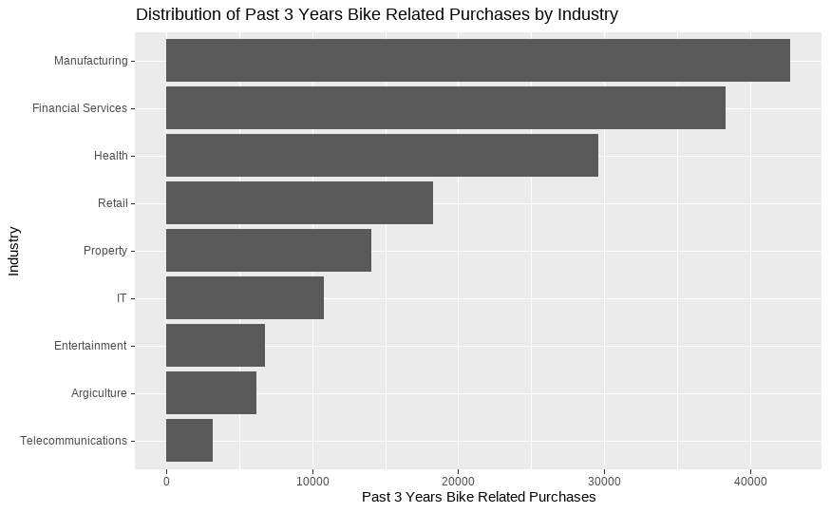
Data Exploration
Existing Customers by Industry
The top 3 industries are Manufacturing, Financial Services, and Health.

Slide 13
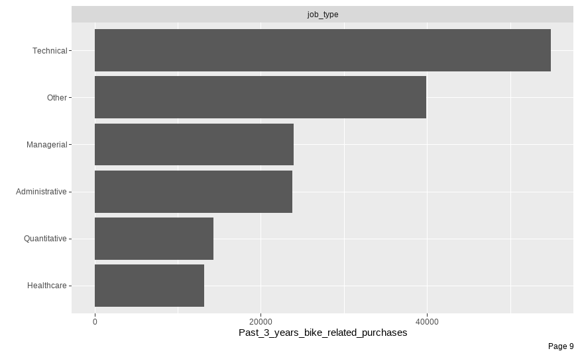
Data Exploration
Existing Customers by Job Type
However, customers with technical professions (programmers, developer, engineers, etc.) have made more purchases than any other job types despite the IT industry not being in the top 3.

Slide 14
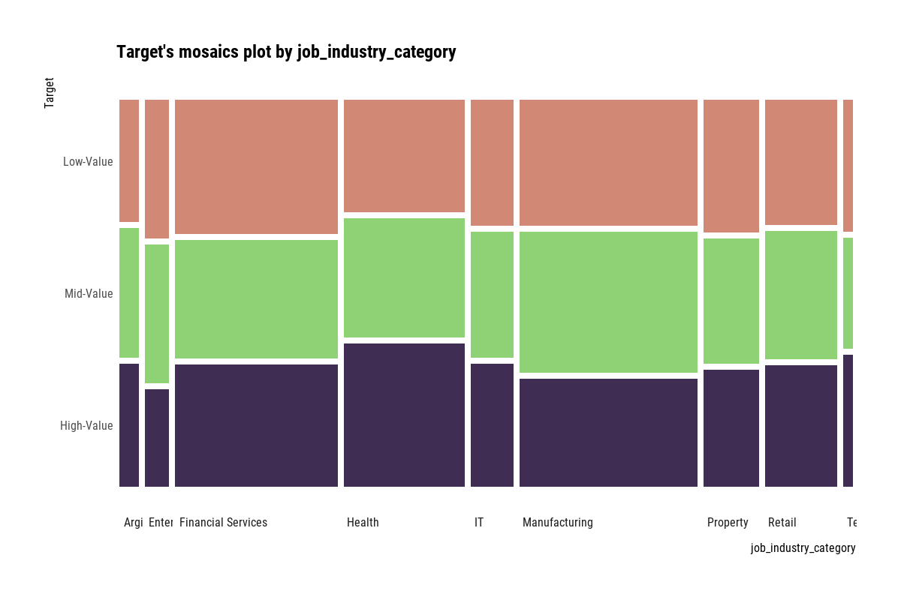
Data Exploration
Existing Customers by Industry and Value segment
The Health industry has the most proportion of High-Value customers.
Meanwhile, Financial Services has the most proportion of Low-Value customers.

Slide 15
Model Development
RFM Analysis
Recency
The number of days since last transaction per customer.
Customers were divided into 4 quartiles and given a R_Score.
Frequency
The frequency of transactions done per customer.
Customers were divided into 4 quartiles and given a F_Score.
Monetary Value
The total profit per customer.
Customers were divided into 4 quartiles and given a M_Score.

Slide 16
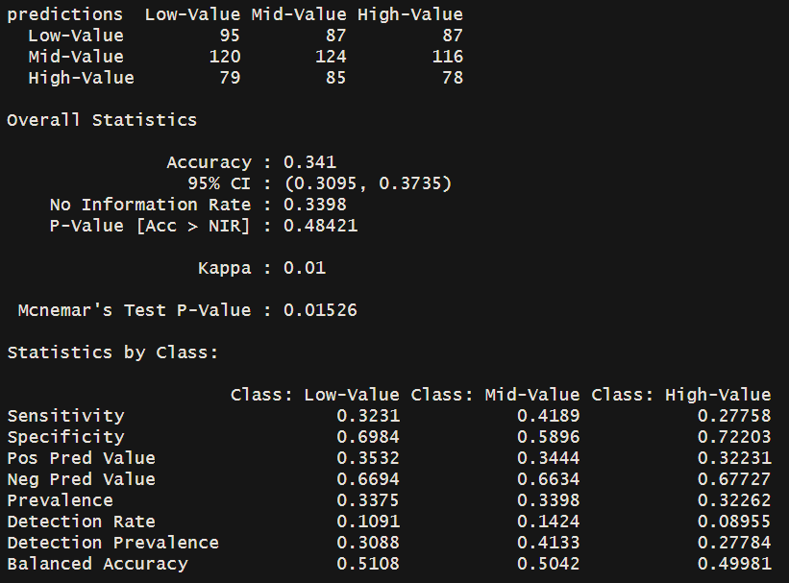
Model Development
Multinomial Logistic Regression

Slide 17
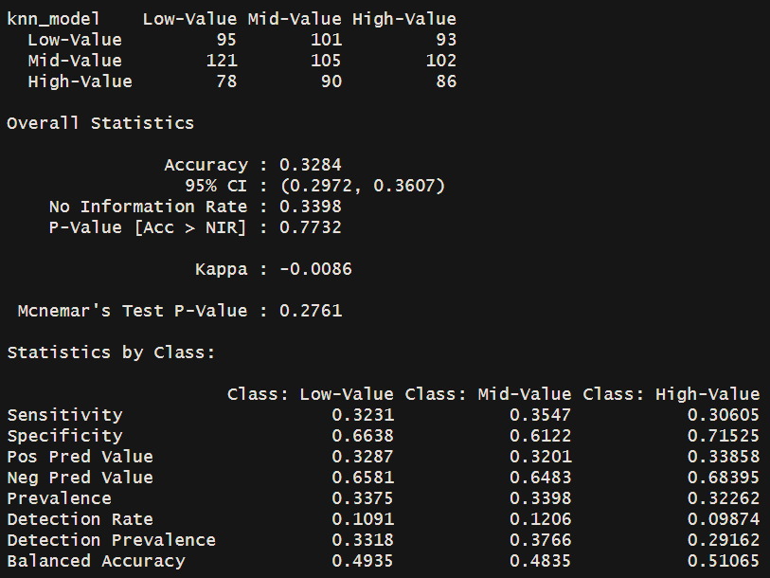
Model Development
K-Nearest Neighbors

Slide 18
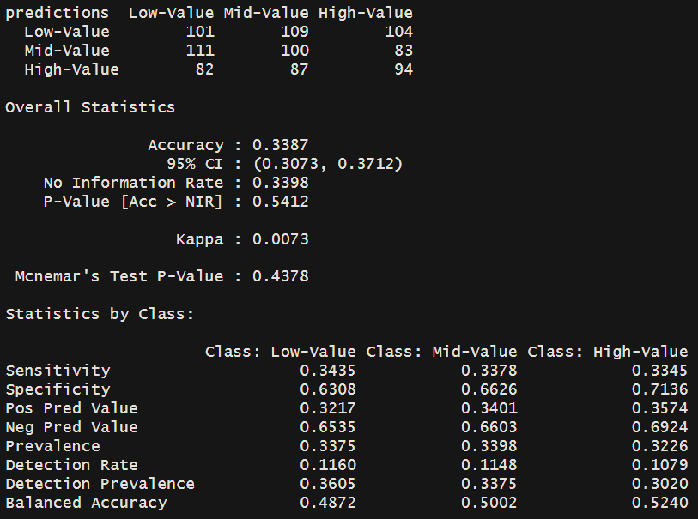
Model Development
Random Forest

Slide 19
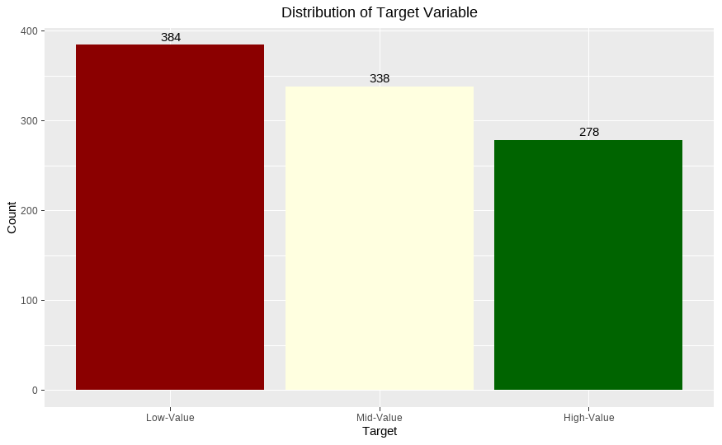
Model Development
Distribution of New Customers by Value segment

Slide 20
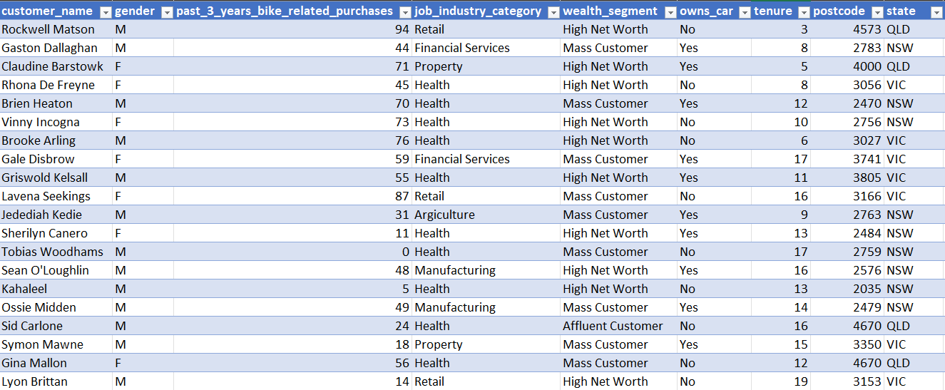
Model Development
Subset of New Customers to target

